Slide 1

Can you explain the price of Electricity – by QRT
Talha Jamal, Chenghu Lyu, Yiru Wang, Krzysztof Plachta, Xinyue Wang

Slide 2
The challenge is to predict electricity futures prices using panel data
Challenge context:
Dsad
Dsa
dsa
Challenge goals:
dsada
Evaluation:

Slide 3
Data processing
Data Features
Issues & Solutions
Missing Data
Useless Features?
DAY_ID
ID
COUNTRY
Interpolation via a Polynomial Function – Why?
Data is non-linear
Dates not given – instead Day ID given. No predictive power hence removed from data.
Reason to drop Country: Preference for One Model for both.
Add Picture for Filling Missing Data

Slide 4
Benchmark Model
Summarize the benchmark model to beat: Linear Regression
In Sample Correlation
Out of Sample Correlation: 15.7 %
Plot of Target Variable
Volatile

Slide 5
Supervised and Unsupervised Machine Learning Models
Model | Why this Model? | Benefits | Drawbacks
Lasso
Ridge
Random Forest
XGBoost
LightGBM
Neural Network

Slide 6
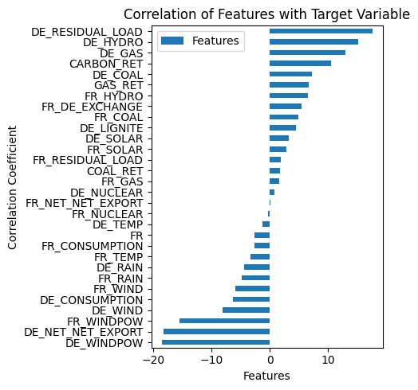
Feature engineering
Correlation of Features with Target Variable
Trying to catch non-linear patterns: Squared Variables of Features
Categorical Variable for Country Column
Removing perfectly colinear features: France and Germany exchanging electricity and vice versa.

Slide 7
Grid Search Optimization of Parameters via Cross Validation

Slide 8
Results
Model | MSE | In Sample Correlation | Out of Sample Correlation
LightGBM |  |  | 27.49%

Slide 9
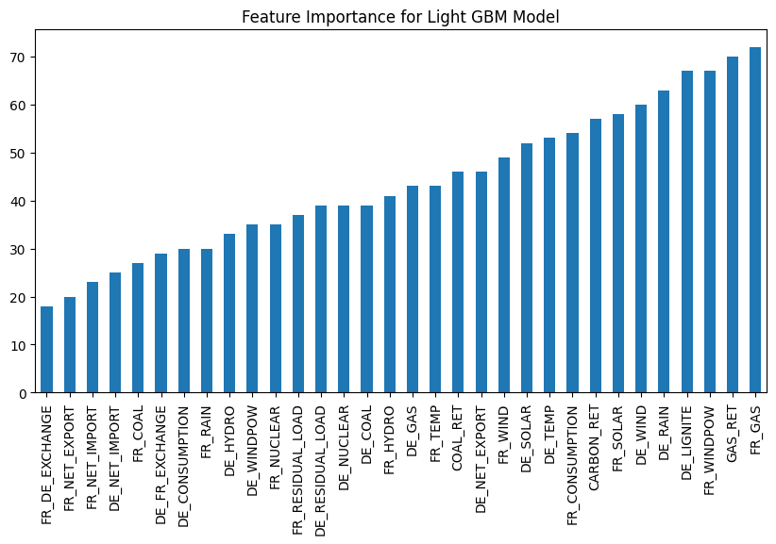
LightGBM Model
Important Features Plot
Explanation of why we think this works?
Important features for predicting electricity prices
Economic Intuition?

Slide 10
Conclusion
Linear Models don’t work
Gradient Boosting Trees perform better
Non-Linear Movement of Target Variable – Future Work to add variables/create features that capture the volatile non-linear movement

